Slide 1
Poba Medical Hardware Check
Michael Bransky, Noah Keyes, Vergil Sorg

Slide 2
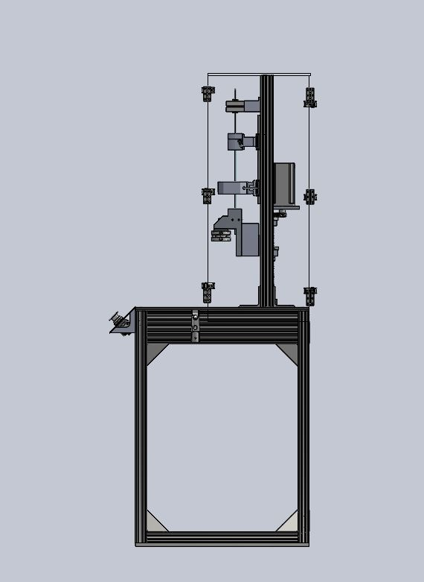
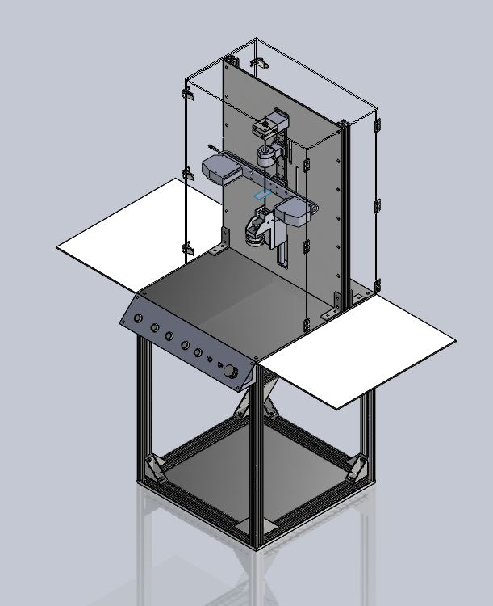
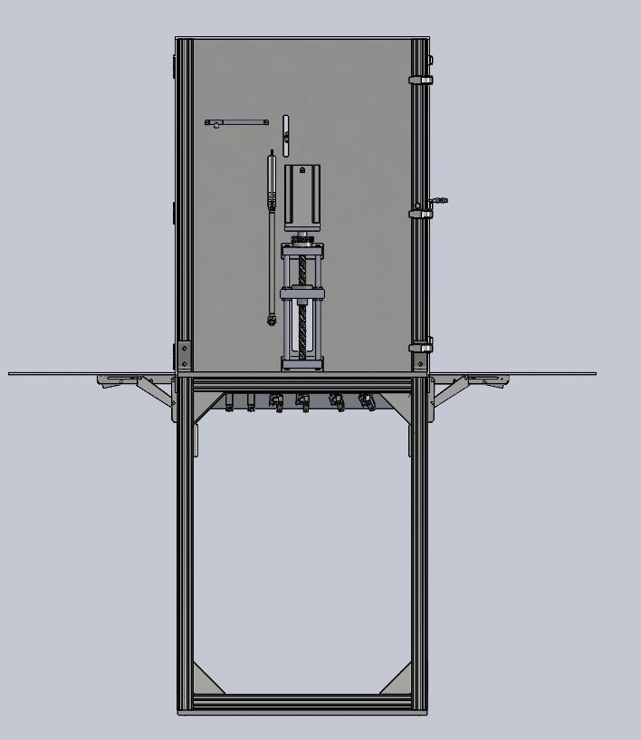
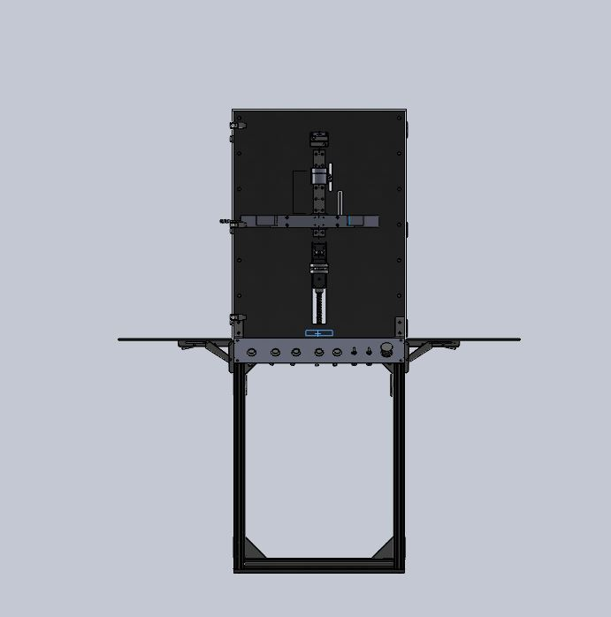
Current CAD

Slide 3
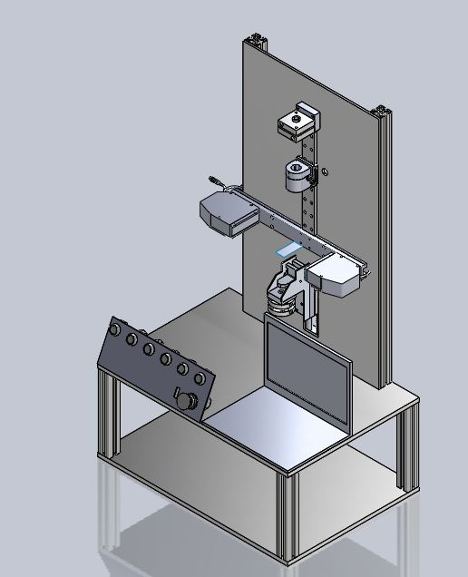
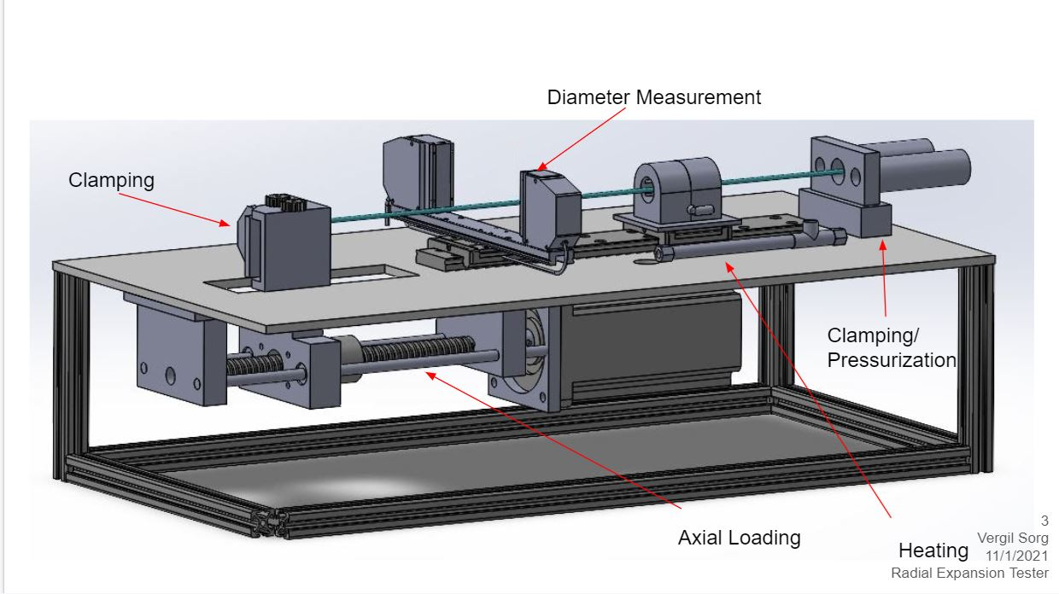
Past Iterations CAD

Slide 4
Purchasing Plan- Overview
Team has purchased 70%+ of parts on BOM
Team still needs to purchase key components including stepper motor, stepper motor driver, etc.
Team has purchased digital micrometer, accounting for 55% of budget
Team has purchased all necessary components for frame
During Assembly, team has found minor errors in BOM that result in delays in assembly

Slide 5
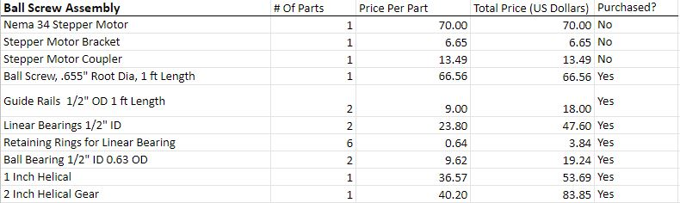
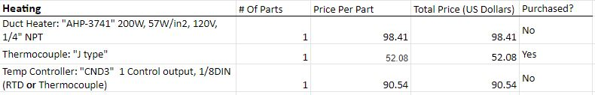
Purchasing Plan - Axial Loading/Heating

Slide 6
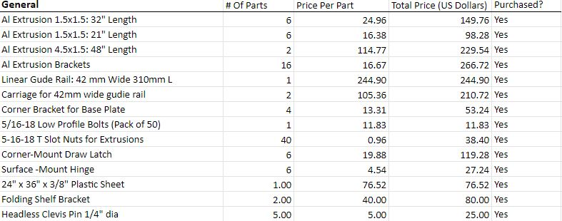
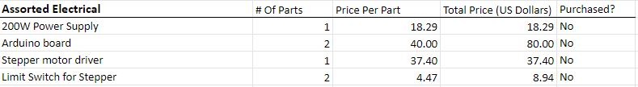
Purchasing Plan- General/Electrical

Slide 7
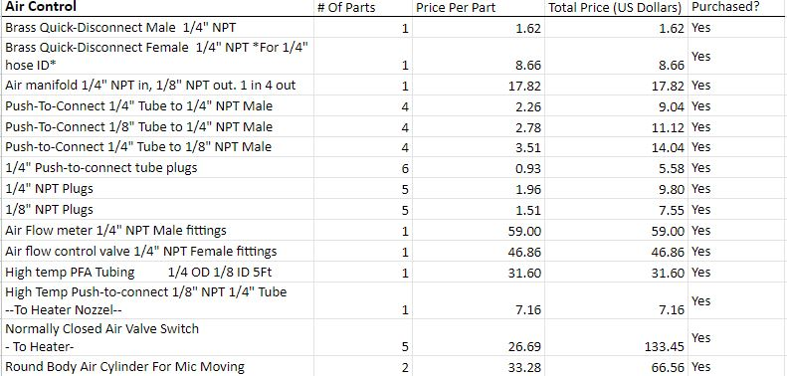
Purchasing Plan - Air/Nitrogen Control

Slide 8
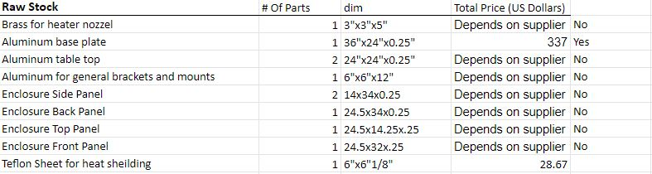
Purchasing Plan - Raw Stock/Digital Micrometer/Clamp

Slide 9
Manufacturing Plan- Overview
Approximately 2 weeks behind schedule
Team members who weren’t shop trained just now getting shop training
Team members who are shop trained will move onto advanced training
Each member will need basic training, CNC Mill, and some familiarity with 3D Printing
Some parts may need to be looked at, such as turning down ends of Ball Screw
Parts can also be partially manufactured at Poba Medical
Even after parts are manufactured machine will need to be wired electrically and pneumatically

Slide 10
Manufacturing Plan
Part | Quantity | Scheduled Week | Done By | Done?
Base Plates | 2x | Week 3 | Vergil | Yes
Extrusions | 2x | Week 3 | Michael | Yes
Lead Screw | 1x | Week 3 | Michael | No
Ball Screw Guide Rail | 2x | Week 3 | Noah | No
Ball Screw Mounting Block | 2x | Week 4 | Michael | No
Flange Nut Mount | 1x | Week 4 | Vergil | No
Button Panel | 1x | Week 4 | Noah | No

Slide 11
Manufacturing Plan
Part | Quantity | Scheduled By: | Done By: | Done?
Heater Nozzle | 2x | Week 5 | Vergil | No
Button Panel Brackets | 2x | Week 5 | Noah | No
Micrometer Mount Pad | 1x | Week 5 | Michael | Np
Enclosure Panels | 5x | Week 6 | All | No
Side Tables | 2x | Week 6 | All | No

Slide 12
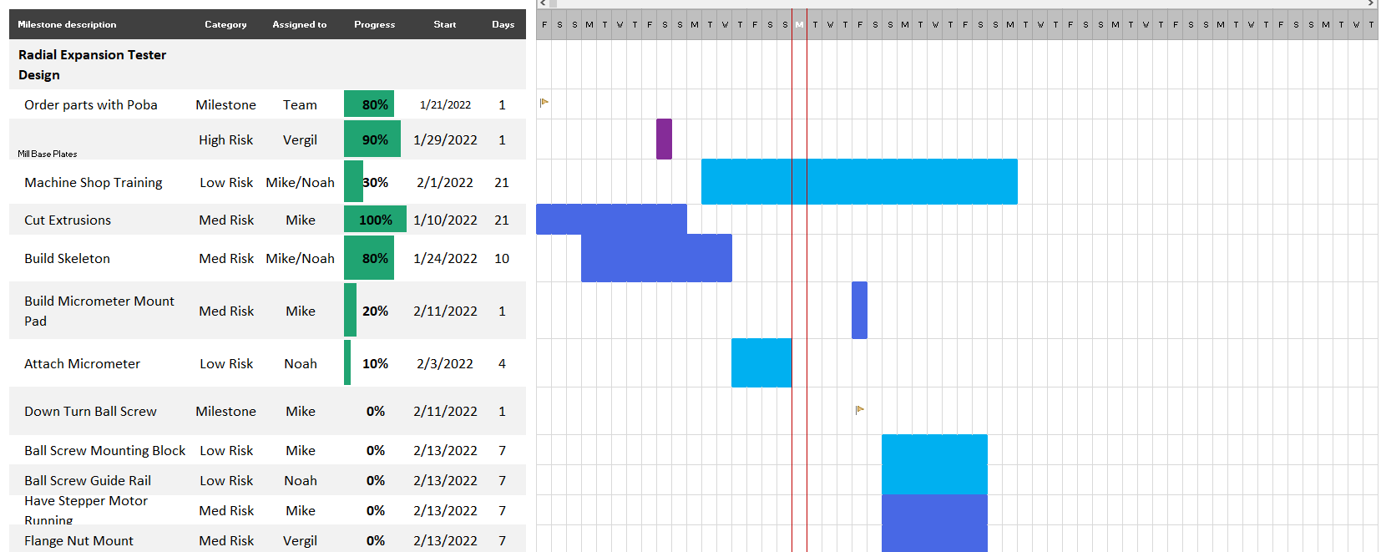
Gantt Chart Update
Team has fallen behind schedule due to slow downs in manufacturing
New Gantt Chart Focuses Heavily on Manufacturing
Team wants to have assembly by end of month so they can spend rest of semester wiring/testing

Slide 13
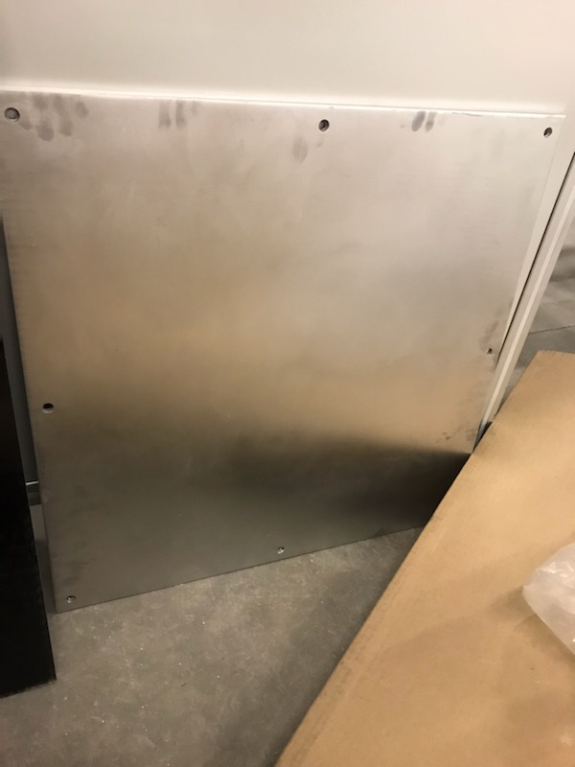
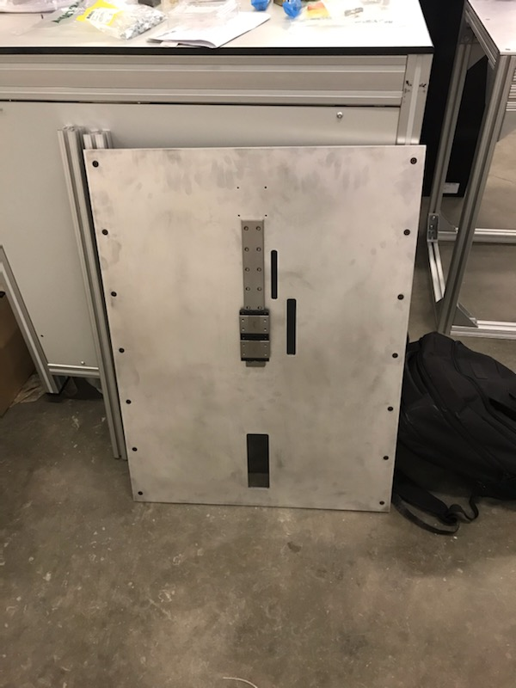
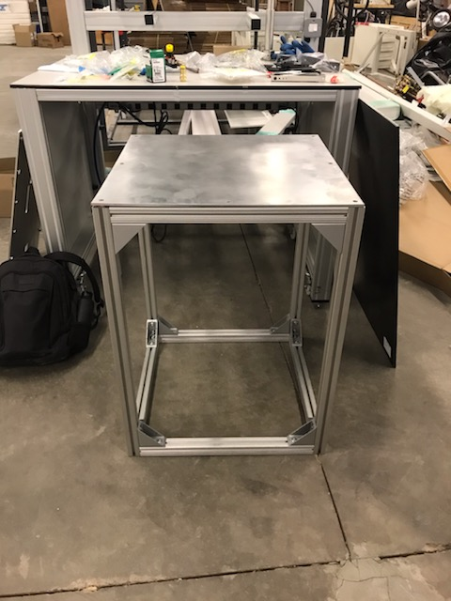
Manufactured Parts/Purchased Parts/Assemblies

Slide 14
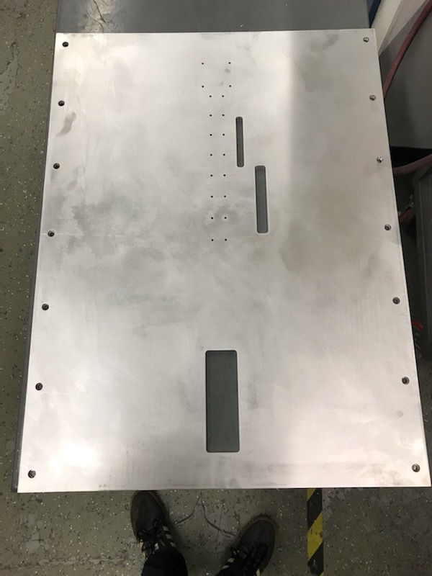
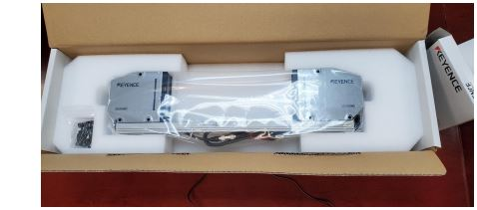
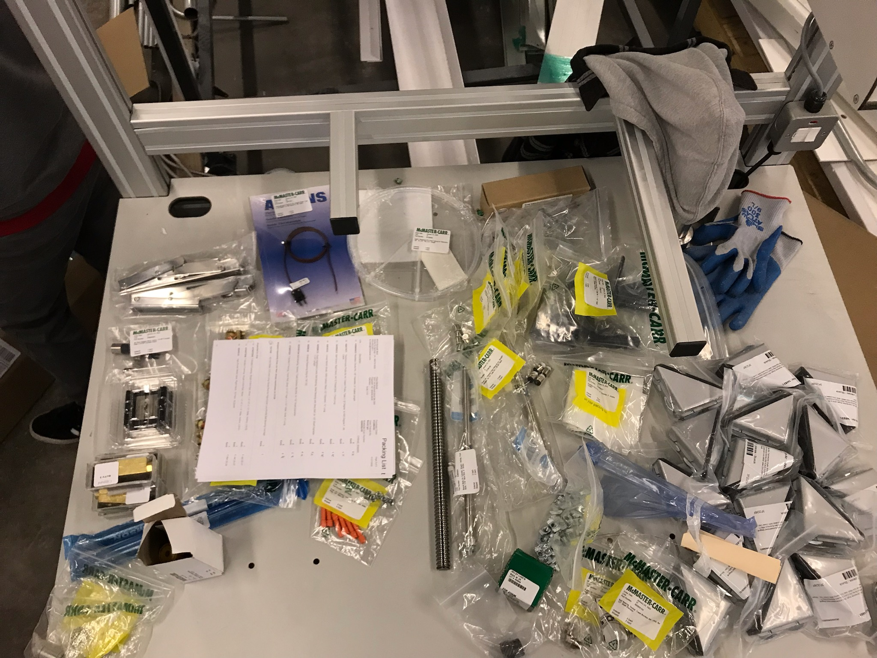
Manufactured Parts/Purchased Parts/Assemblies

